Slide 1
Organic Chemistry, 8e by L. G. Wade, Jr.
Chapter 5
Clickers
Stereochemistry

Slide 2
5.1 Compare the physical properties of enantiomers.
a) Different physical properties
b) Same physical properties
c) Cannot determine
d) Same chemical properties

Slide 3
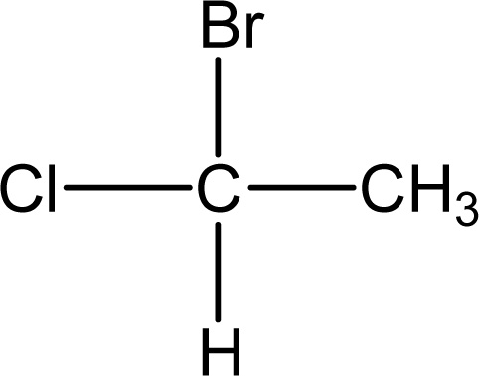
5.2 Identify as R, S, or achiral.
a) R
b) S
c) Achiral
d) Cannot be determined

Slide 4
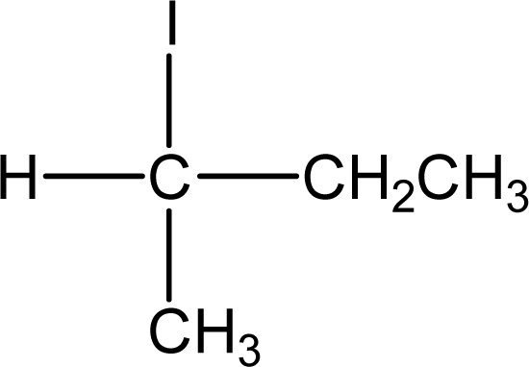
5.3 Identify as R, S, or achiral.
a) R
b) S
c) Achiral
d) Cannot be determined

Slide 5
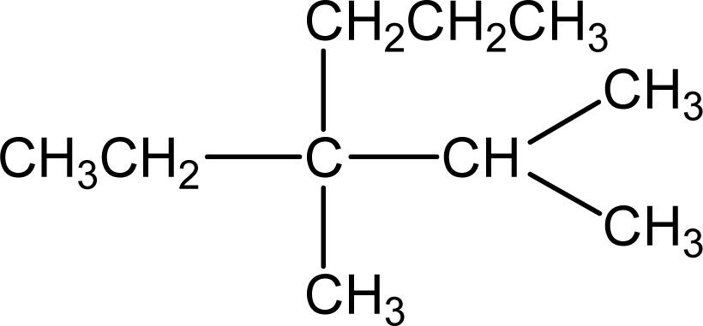
5.4 Identify as R, S, or achiral.
a) R
b) S
c) Achiral
d) Cannot be determined

Slide 6
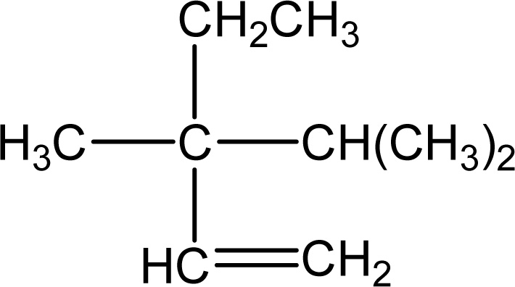
5.5 Identify as R, S, or achiral.
a) R
b) S
c) Achiral
d) Cannot be determined

Slide 7
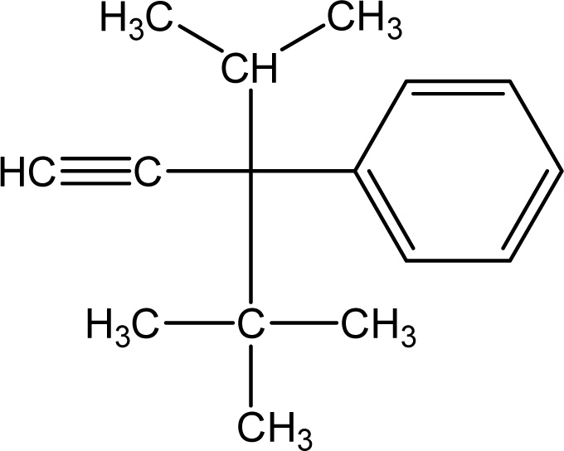
5.6 Identify as R, S, or achiral.
a) R
b) S
c) Achiral
d) Cannot be determined

Slide 8
5.7 Identify the type isomer for (R)-2-pentanol.
a) Dextrorotatory isomer
b) Levorotatory isomer
c) Has to be experimentally determined
d) Neither

Slide 9
5.8 Calculate specific rotation of
5.00 g/20.0 mL; observed rotation of -40°; 5 dm cell.
a) -32°
b) 32°
c) 2°
d) -2°

Slide 10
5.9 Explain an enantiomeric excess of 30% (-).
a) 70% (+) and 30% (-)
b) 70% (-) and 30% (+)
c) 65% (+) and 35% (-)
d) 65% (-) and 35% (+)

Slide 11
5.10 Identify the type of alkene in CH₃CH=C=CH₂.
a) Isolated diene
b) Conjugated diene
c) Allene
d) Alkyne

Slide 12
5.11 Classify 2R,3S-2,3-dichloropentane and 2S,3S-2,3-dichloropentane.
a) Enantiomers
b) Diastereomers
c) Conformational isomers
d) Constitutional isomers
e) Identical

Slide 13
5.12 Classify 2S,3S-2,3-dichloropentane and 2R,3R-2,3-dichloropentane.
a) Enantiomers
b) Diastereomers
c) Conformational isomers
d) Constitutional isomers
e) Identical

Slide 14
5.13 Classify 2R,3S-2,3-dichlorobutane and 2S,3R-2,3-dichlorobutane.
a) Enantiomers
b) Diastereomers
c) Conformational isomers
d) Constitutional isomers
e) Identical

Slide 15
5.14 Classify 2R,3R-2,3-dichlorobutane and 2S,3S-2,3-dichlorobutane.
a) Enantiomers
b) Diastereomers
c) Conformational isomers
d) Constitutional isomers
e) Identical

Slide 16
5.15 Identify the number of stereoisomers for
3-bromo-2,4,5-trichlorohexane.
a) 6 stereoisomers
b) 8 stereoisomers
c) 12 stereoisomers
d) 16 stereoisomers
e) 24 stereoisomers

Slide 17
5.16 Define a meso compound.
a) A meso compound is an achiral molecule
b) A meso compound has a plane of symmetry.
c) A meso compound has chiral carbons.
d) All of the above

Slide 18
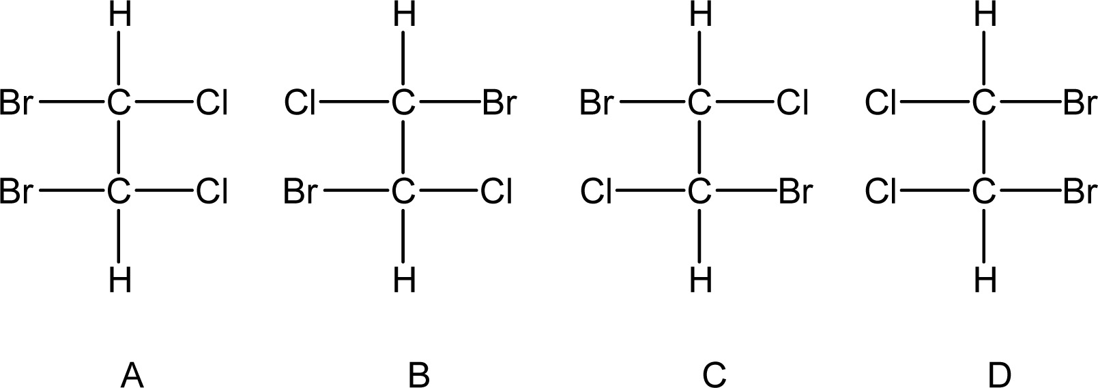
5.17 Identify a pair of diastereomers.
a) A and B
b) A and D
c) B and C
d) None

Slide 19

5.18 Identify a pair of enantiomers.
a) A and B
b) B and D
c) B and C
d) A and C

Slide 20

5.19 Identify a meso compound.
a) A
b) B
c) C
d) A and D

Slide 21
5.20 Compare the physical properties of diastereomers.
a) Different physical properties
b) Same physical properties
c) Cannot determine
d) Same chemical properties

